Slide 1
SQL, ARM, Azure
ISAH 28 April 2022

Slide 2
Vandaag
Azure SQL
ARM Templates
Azure Design Patterns / Azure Design Center

Slide 3
Azure sql
Azure SQL is a family of managed, secure, and intelligent products that use the SQL Server database engine in the Azure cloud.
Azure SQL Database: Support modern cloud applications on an intelligent, managed database service, that includes serverless compute.
Azure SQL Managed Instance: Modernize your existing SQL Server applications at scale with an intelligent fully managed instance as a service, with almost 100% feature parity with the SQL Server database engine. Best for most migrations to the cloud.
SQL Server on Azure VMs: Lift-and-shift your SQL Server workloads with ease and maintain 100% SQL Server compatibility and operating system-level access.

Slide 4
Business motivations - cost
Both platform as a service (PaaS) and infrastructure as a service (IaaS) options include base price that covers underlying infrastructure and licensing. However, with the IaaS option you need to invest additional time and resources to manage your database, while in PaaS you get these administration features included in the price. IaaS enables you to shut down resources while you are not using them to decrease the cost, while PaaS is always running unless you drop and re-create your resources when they are needed.

Slide 5
Business motivations - administration
PaaS options reduce the amount of time that you need to invest to administer the database. However, it also limits the range of custom administration tasks and scripts that you can perform or run. For example, the CLR is not supported with SQL Database, but is supported for an instance of SQL Managed Instance. Also, no deployment options in PaaS support the use of trace flags.

Slide 6
Business motivations - SLA
Both IaaS and PaaS provide high, industry standard SLA. PaaS option guarantees 99.99% SLA, while IaaS guarantees 99.95% SLA for infrastructure, meaning that you need to implement additional mechanisms to ensure availability of your databases. You can attain 99.99% SLA by creating an additional SQL virtual machine, and implementing the SQL Server Always On availability group high availability solution.

Slide 7
Business motivations – Moving to azure
SQL Server on Azure VM is the exact match of your environment, so migration from on-premises to the Azure VM is no different than moving the databases from one on-premises server to another. SQL Managed Instance also enables easy migration; however, there might be some changes that you need to apply before your migration.

Slide 8
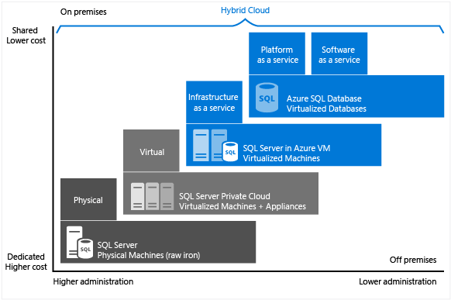
Service comparison

Slide 9
Azure sql database
Azure SQL Database is a relational database-as-a-service (DBaaS) hosted in Azure that falls into the industry category of Platform-as-a-Service (PaaS).
Best for modern cloud applications that want to use the latest stable SQL Server features and have time constraints in development and marketing.
A fully managed SQL Server database engine, based on the latest stable Enterprise Edition of SQL Server. SQL Database has two deployment options built on standardized hardware and software that is owned, hosted, and maintained by Microsoft.
Notes:
https://docs.microsoft.com/en-us/azure/azure-sql/database/sql-database-paas-overview?view=azuresql

Slide 10
Azure sql database - deployment
Azure SQL Database provides the following deployment options for a database:
Single database represents a fully managed, isolated database. You might use this option if you have modern cloud applications and microservices that need a single reliable data source. A single database is similar to a contained database in the SQL Server database engine.
Elastic pool is a collection of single databases with a shared set of resources, such as CPU or memory. Single databases can be moved into and out of an elastic pool.

Slide 11
Azure sql database - performance
With single databases, each database is isolated from others and is portable. Each has its own guaranteed amount of compute, memory, and storage resources. The amount of the resources assigned to the database is dedicated to that database, and isn't shared with other databases in Azure. You can dynamically scale single database resources up and down. The single database option provides different compute, memory, and storage resources for different needs. For example, you can get 1 to 128 vCores, or 32 GB to 4 TB. The Hyperscale service tier for single databases enables you to scale to 100 TB, with fast backup and restore capabilities.
With elastic pools, you can assign resources that are shared by all databases in the pool. You can create a new database, or move the existing single databases into a resource pool to maximize the use of resources and save money. This option also gives you the ability to dynamically scale elastic pool resources up and down.

Slide 12
Azure sql database - scaling
Dynamic scalability is different from autoscale. Autoscale is when a service scales automatically based on criteria, whereas dynamic scalability allows for manual scaling without downtime. The single database option supports manual dynamic scalability, but not autoscale. For a more automatic experience, consider using elastic pools, which allow databases to share resources in a pool based on individual database needs. Another option is to use scripts that can help automate scalability for a single database.
https://docs.microsoft.com/en-us/azure/azure-sql/database/scripts/monitor-and-scale-database-powershell?view=azuresql

Slide 13
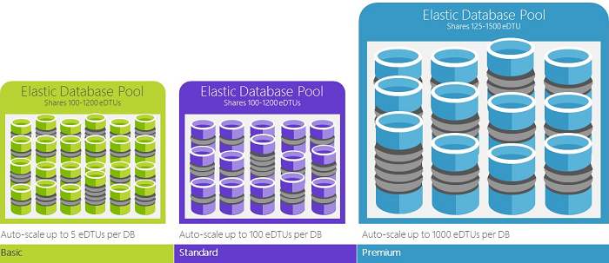
Azure sql database – elastic pool
Databases share the resources of the Elastic Database Pool

Slide 14
Azure sql database – purchasing models
SQL Database offers the following purchasing models:
The vCore-based purchasing model lets you choose the number of vCores, the amount of memory, and the amount and speed of storage. The vCore-based purchasing model also allows you to use Azure Hybrid Benefit for SQL Server to gain cost savings. For more information about the Azure Hybrid Benefit, see the Frequently asked questions section later in this article.
The DTU-based purchasing model offers a blend of compute, memory, and I/O resources in three service tiers, to support light to heavy database workloads. Compute sizes within each tier provide a different mix of these resources, to which you can add additional storage resources.

Slide 15
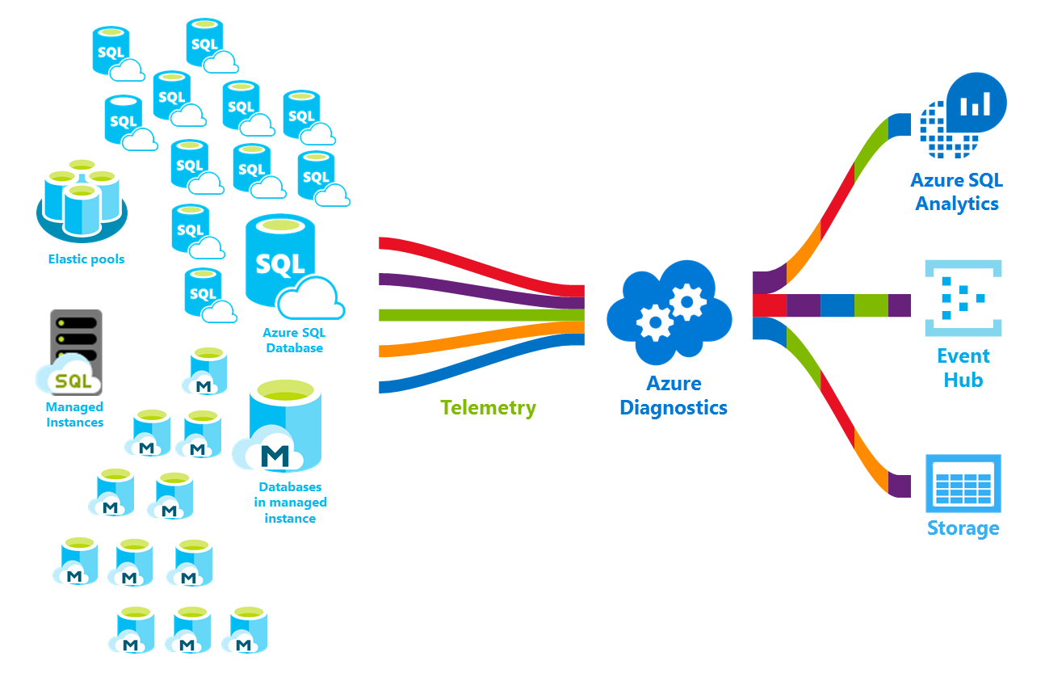
Azure sql database - monitoring

Slide 16
Azure sql database - demo

Slide 17
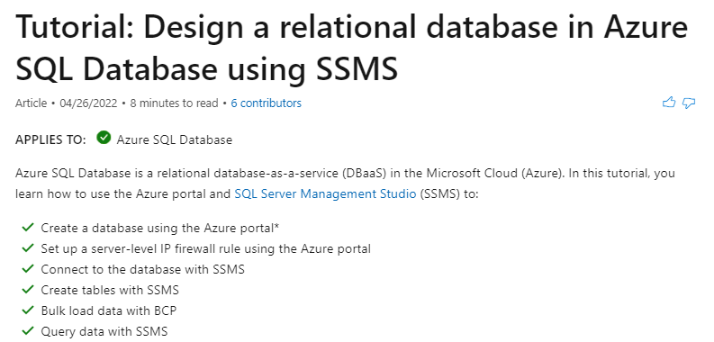
Azure sql database - exercise
https://docs.microsoft.com/en-us/azure/azure-sql/database/design-first-database-tutorial?view=azuresql

Slide 18
Azure sql managed instance
Azure SQL Managed Instance falls into the industry category of Platform-as-a-Service (PaaS), and is best for most migrations to the cloud. SQL Managed Instance is a collection of system and user databases with a shared set of resources that is lift-and-shift ready.
Best for new applications or existing on-premises applications that want to use the latest stable SQL Server features and that are migrated to the cloud with minimal changes. An instance of SQL Managed Instance is similar to an instance of the Microsoft SQL Server database engine offering shared resources for databases and additional instance-scoped features.
SQL Managed Instance supports database migration from on-premises with minimal to no database change. This option provides all of the PaaS benefits of Azure SQL Database but adds capabilities that were previously only available in SQL Server VMs. This includes a native virtual network and near 100% compatibility with on-premises SQL Server. Instances of SQL Managed Instance provide full SQL Server access and feature compatibility for migrating SQL Servers to Azure.
Notes:
https://docs.microsoft.com/en-us/azure/azure-sql/managed-instance/sql-managed-instance-paas-overview?view=azuresql

Slide 19
Azure sql managed instance - migrating
Azure SQL Managed Instance is designed for customers looking to migrate a large number of apps from an on-premises or IaaS, self-built, or ISV provided environment to a fully managed PaaS cloud environment, with as low a migration effort as possible. Using the fully automated Azure Data Migration Service, customers can lift and shift their existing SQL Server instance to SQL Managed Instance, which offers compatibility with SQL Server and complete isolation of customer instances with native VNet support. For more information on migration options and tools, see Migration overview: SQL Server to Azure SQL Managed Instance.
With Software Assurance, you can exchange your existing licenses for discounted rates on SQL Managed Instance using the Azure Hybrid Benefit for SQL Server. SQL Managed Instance is the best migration destination in the cloud for SQL Server instances that require high security and a rich programmability surface.

Slide 20
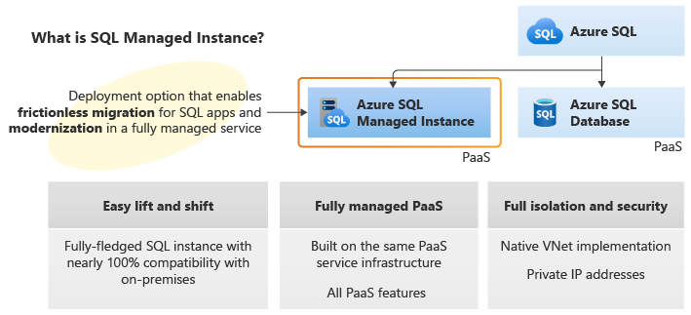
Azure sql managed instance

Slide 21
differences with SQL Server on-premises
SQL Managed Instance benefits from being always-up-to-date in the cloud, which means that some features in SQL Server may be obsolete, be retired, or have alternatives. There are specific cases when tools need to recognize that a particular feature works in a slightly different way or that the service is running in an environment you do not fully control.
High availability is built in and pre-configured using technology similar to Always On availability groups.
There are only automated backups and point-in-time restore. Customers can initiate copy-only backups that do not interfere with the automatic backup chain.

Slide 22
Azure sql managed instance - demo

Slide 23
Sql server on azure vm
SQL Server on Azure VM falls into the industry category Infrastructure-as-a-Service (IaaS) and allows you to run SQL Server inside a fully managed virtual machine (VM) in Azure.
SQL Server installed and hosted in the cloud runs on Windows Server or Linux virtual machines running on Azure, also known as an infrastructure as a service (IaaS). SQL virtual machines are a good option for migrating on-premises SQL Server databases and applications without any database change. All recent versions and editions of SQL Server are available for installation in an IaaS virtual machine.
Best for migrations and applications requiring OS-level access. SQL virtual machines in Azure are lift-and-shift ready for existing applications that require fast migration to the cloud with minimal changes or no changes. SQL virtual machines offer full administrative control over the SQL Server instance and underlying OS for migration to Azure.

Slide 24
Sql server on azure vm
he most significant difference from SQL Database and SQL Managed Instance is that SQL Server on Azure Virtual Machines allows full control over the database engine. You can choose when to start maintenance/patching, change the recovery model to simple or bulk-logged, pause or start the service when needed, and you can fully customize the SQL Server database engine. With this additional control comes the added responsibility to manage the virtual machine.
Rapid development and test scenarios when you do not want to buy on-premises non-production SQL Server hardware. SQL virtual machines also run on standardized hardware that is owned, hosted, and maintained by Microsoft. When using SQL virtual machines, you can either pay-as-you-go for a SQL Server license already included in a SQL Server image or easily use an existing license. You can also stop or resume the VM as needed.

Slide 25
Sql server on azure vm
Optimized for migrating existing applications to Azure or extending existing on-premises applications to the cloud in hybrid deployments. In addition, you can use SQL Server in a virtual machine to develop and test traditional SQL Server applications. With SQL virtual machines, you have the full administrative rights over a dedicated SQL Server instance and a cloud-based VM. It is a perfect choice when an organization already has IT resources available to maintain the virtual machines. These capabilities allow you to build a highly customized system to address your application’s specific performance and availability requirements.

Slide 26
Sql server on azure vm - demo

Slide 27
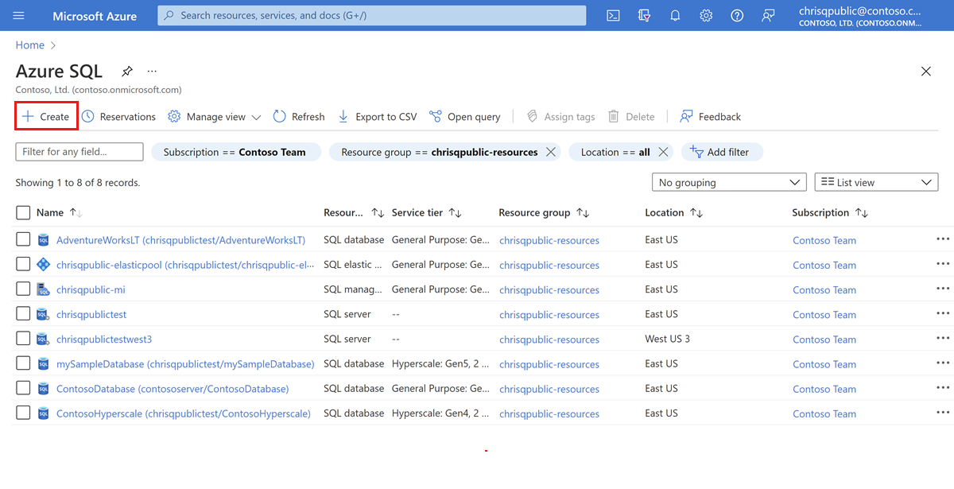
Azure sql resources with azure portal
The Azure portal provides a single page where you can manage all of your Azure SQL resources including your SQL Server on Azure virtual machines (VMs).
To access the Azure SQL page, from the Azure portal menu, select Azure SQL or search for and select Azure SQL in any page.

Slide 28
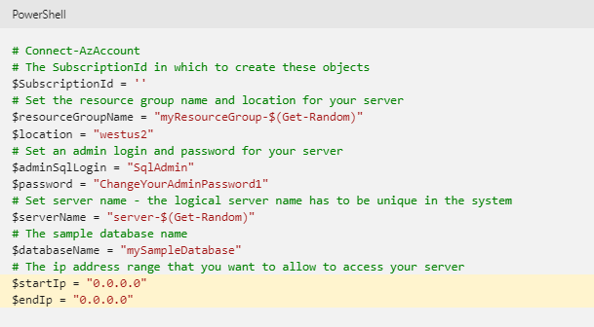
Azure sql powershell
Notes:
https://docs.microsoft.com/en-us/azure/azure-sql/database/powershell-script-content-guide?view=azuresql&tabs=single-database

Slide 29
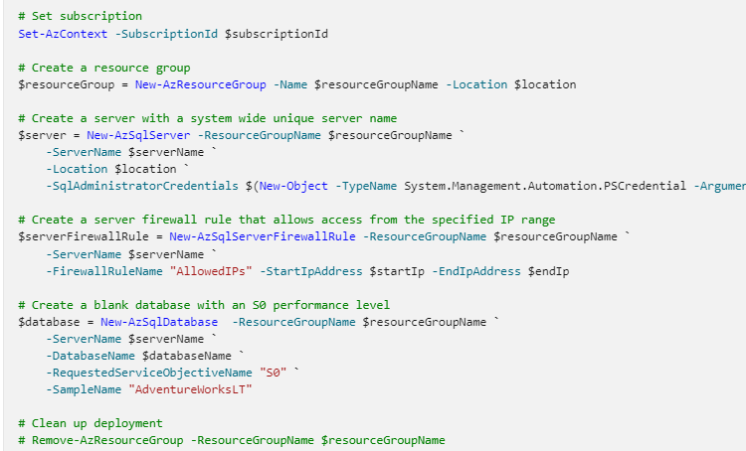
-SqlAdministratorCredentials $(New-Object -TypeName System.Management.Automation.PSCredential -ArgumentList $adminSqlLogin, $(ConvertTo-SecureString -String $password -AsPlainText -Force))

Slide 30
Access to azure databases
By default Azure SQL Databases have an allowed IP list to ensure that not everybody can access the database

Slide 31
SQL Server management studio
Connecting to a database hosted in Azure

Slide 32
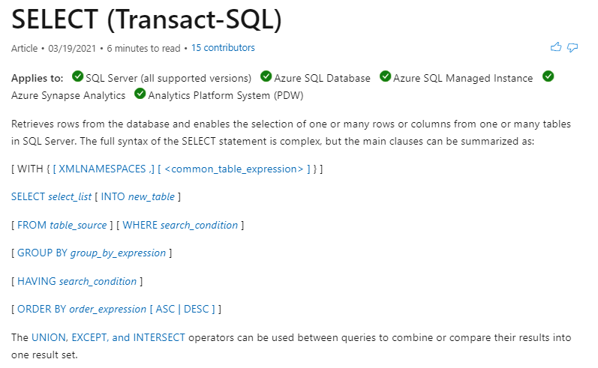
T-sql basics

Slide 33
Entity framework core
Entity Framework (EF) Core is a lightweight, extensible, open source and cross-platform version of the popular Entity Framework data access technology.
EF Core can serve as an object-relational mapper (O/RM), which:
Enables .NET developers to work with a database using .NET objects.
Eliminates the need for most of the data-access code that typically needs to be written.
EF Core supports many database engines
Notes:
https://docs.microsoft.com/en-us/ef/core/

Slide 34
Enitity framework - model
With EF Core, data access is performed using a model. A model is made up of entity classes and a context object that represents a session with the database. The context object allows querying and saving data.
EF supports the following model development approaches:
Generate a model from an existing database.
Hand code a model to match the database.
Once a model is created, use EF Migrations to create a database from the model. Migrations allow evolving the database as the model changes.
Notes:
https://docs.microsoft.com/en-us/ef/core/modeling/

Slide 35
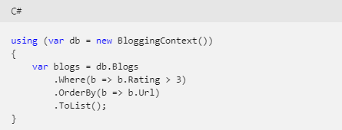
querying
Instances of your entity classes are retrieved from the database using Language Integrated Query (LINQ). For more information
Notes:
https://docs.microsoft.com/en-us/ef/core/querying/

Slide 36
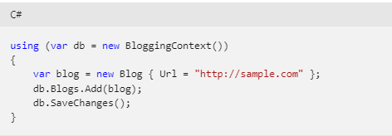
Saving data
Data is created, deleted, and modified in the database using instances of your entity classes.
Notes:
https://docs.microsoft.com/en-us/ef/core/saving/

Slide 37
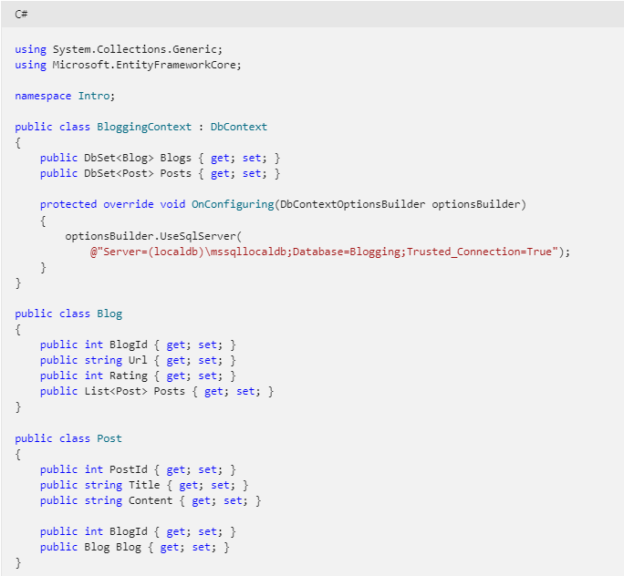

Slide 38
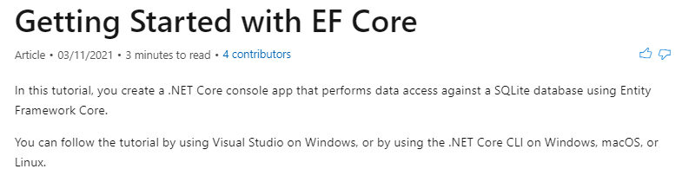
Entity framework core - exercise
https://docs.microsoft.com/en-us/ef/core/get-started/overview/first-app?tabs=netcore-cli

Slide 39
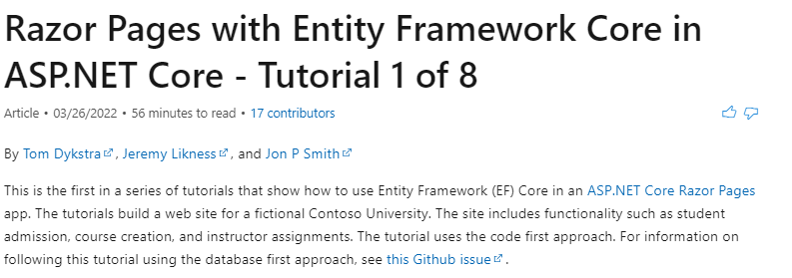
Entity framework core - exercise
https://docs.microsoft.com/en-us/aspnet/core/data/ef-rp/intro?view=aspnetcore-6.0&tabs=visual-studio

Slide 40
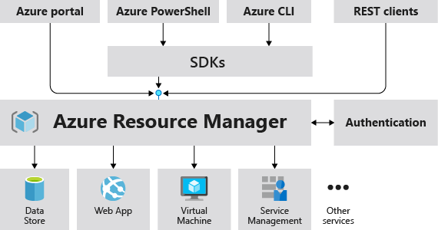
Azure resource manager (arm)
Notes:
https://docs.microsoft.com/en-us/azure/azure-resource-manager/templates/overview

Slide 41
Arm templates
With the move to the cloud, many teams have adopted agile development methods. These teams iterate quickly. They need to repeatedly deploy their solutions to the cloud, and know their infrastructure is in a reliable state. As infrastructure has become part of the iterative process, the division between operations and development has disappeared. Teams need to manage infrastructure and application code through a unified process.
To meet these challenges, you can automate deployments and use the practice of infrastructure as code. In code, you define the infrastructure that needs to be deployed. The infrastructure code becomes part of your project. Just like application code, you store the infrastructure code in a source repository and version it. Any one on your team can run the code and deploy similar environments.

Slide 42
Arm templates
To implement infrastructure as code for your Azure solutions, use Azure Resource Manager templates (ARM templates). The template is a JavaScript Object Notation (JSON) file that defines the infrastructure and configuration for your project. The template uses declarative syntax, which lets you state what you intend to deploy without having to write the sequence of programming commands to create it. In the template, you specify the resources to deploy and the properties for those resources.

Slide 43
Arm templates – why?
If you're trying to decide between using ARM templates and one of the other infrastructure as code services, consider the following advantages of using templates:
Declarative syntax: ARM templates allow you to create and deploy an entire Azure infrastructure declaratively. For example, you can deploy not only virtual machines, but also the network infrastructure, storage systems, and any other resources you may need.
Repeatable results: Repeatedly deploy your infrastructure throughout the development lifecycle and have confidence your resources are deployed in a consistent manner. Templates are idempotent, which means you can deploy the same template many times and get the same resource types in the same state. You can develop one template that represents the desired state, rather than developing lots of separate templates to represent updates.

Slide 44
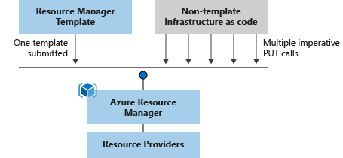
Arm templates – why?
Orchestration: You don't have to worry about the complexities of ordering operations. Resource Manager orchestrates the deployment of interdependent resources so they're created in the correct order. When possible, Resource Manager deploys resources in parallel so your deployments finish faster than serial deployments. You deploy the template through one command, rather than through multiple imperative commands.

Slide 45
Arm templates – why?
Modular files: You can break your templates into smaller, reusable components and link them together at deployment time. You can also nest one template inside another template.
Create any Azure resource: You can immediately use new Azure services and features in templates. As soon as a resource provider introduces new resources, you can deploy those resources through templates. You don't have to wait for tools or modules to be updated before using the new services.
Extensibility: With deployment scripts, you can add PowerShell or Bash scripts to your templates. The deployment scripts extend your ability to set up resources during deployment. A script can be included in the template, or stored in an external source and referenced in the template. Deployment scripts give you the ability to complete your end-to-end environment setup in a single ARM template.
Notes:
https://docs.microsoft.com/en-us/azure/azure-resource-manager/templates/deployment-script-template

Slide 46
Arm templates – why?
Testing: You can make sure your template follows recommended guidelines by testing it with the ARM template tool kit (arm-ttk). This test kit is a PowerShell script that you can download from GitHub. The tool kit makes it easier for you to develop expertise using the template language.
Preview changes: You can use the what-if operation to get a preview of changes before deploying the template. With what-if, you see which resources will be created, updated, or deleted, and any resource properties that will be changed. The what-if operation checks the current state of your environment and eliminates the need to manage state.
Built-in validation: Your template is deployed only after passing validation. Resource Manager checks the template before starting the deployment to make sure the deployment will succeed. Your deployment is less likely to stop in a half-finished state.

Slide 47
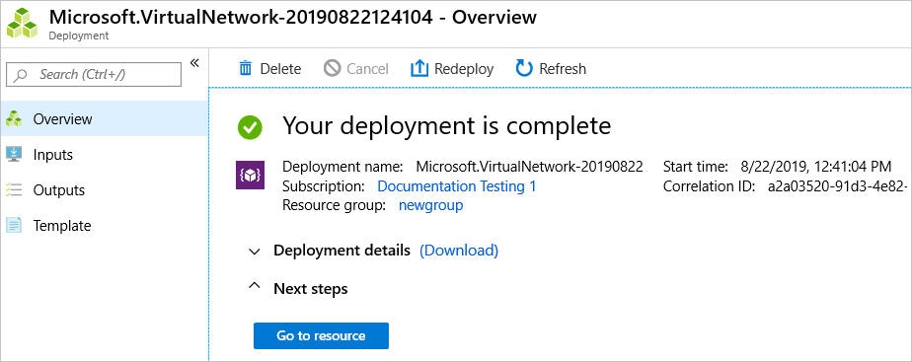
Arm templates – why?
Tracked deployments: In the Azure portal, you can review the deployment history and get information about the template deployment. You can see the template that was deployed, the parameter values passed in, and any output values. Other infrastructure as code services aren't tracked through the portal.

Slide 48
Arm templates – why?
Policy as code: Azure Policy is a policy as code framework to automate governance. If you're using Azure policies, policy remediation is done on non-compliant resources when deployed through templates.
Deployment Blueprints: You can take advantage of Blueprints provided by Microsoft to meet regulatory and compliance standards. These blueprints include pre-built templates for various architectures.
CI/CD integration: You can integrate templates into your continuous integration and continuous deployment (CI/CD) tools, which can automate your release pipelines for fast and reliable application and infrastructure updates. By using Azure DevOps and Resource Manager template task, you can use Azure Pipelines to continuously build and deploy ARM template projects.
Notes:
https://docs.microsoft.com/en-us/azure/governance/policy/overview
https://docs.microsoft.com/en-us/azure/governance/blueprints/overview
https://docs.microsoft.com/en-us/azure/azure-resource-manager/templates/deployment-tutorial-pipeline

Slide 49
Arm templates – why?
Exportable code: You can get a template for an existing resource group by either exporting the current state of the resource group, or viewing the template used for a particular deployment. Viewing the exported template is a helpful way to learn about the template syntax.
Authoring tools: You can author templates with Visual Studio Code and the template tool extension. You get intellisense, syntax highlighting, in-line help, and many other language functions. In addition to Visual Studio Code, you can also use Visual Studio.
Notes:
https://docs.microsoft.com/en-us/azure/azure-resource-manager/templates/export-template-portal

Slide 50
Arm template file
Within your template, you can write template expressions that extend the capabilities of JSON. These expressions make use of the functions provided by Resource Manager.
The template has the following sections:
Parameters - Provide values during deployment that allow the same template to be used with different environments.
Variables - Define values that are reused in your templates. They can be constructed from parameter values.
User-defined functions - Create customized functions that simplify your template.
Resources - Specify the resources to deploy.
Outputs - Return values from the deployed resources.

Slide 51
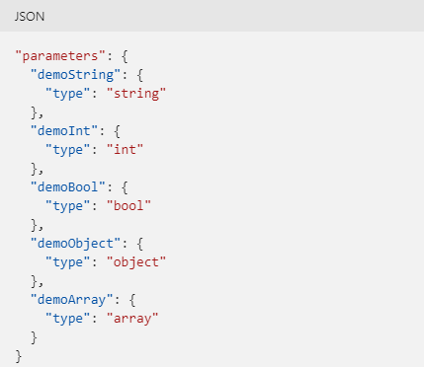
Arm parameters
By providing different values for parameters, you can reuse a template for different environments.
Resource Manager resolves parameter values before starting the deployment operations. Wherever the parameter is used in the template, Resource Manager replaces it with the resolved value.
Notes:
https://docs.microsoft.com/en-us/azure/azure-resource-manager/templates/parameters

Slide 52
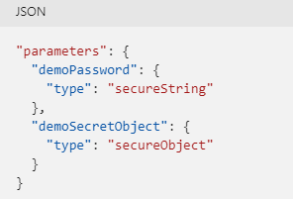
Secure parameters
You can mark string or object parameters as secure. The value of a secure parameter isn't saved to the deployment history and isn't logged.

Slide 53
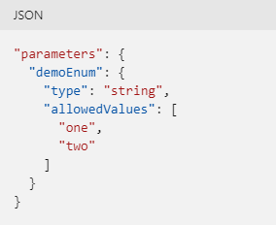
Allowed values
You can define allowed values for a parameter. You provide the allowed values in an array. The deployment fails during validation if a value is passed in for the parameter that isn't one of the allowed values.

Slide 54
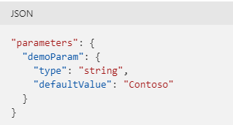
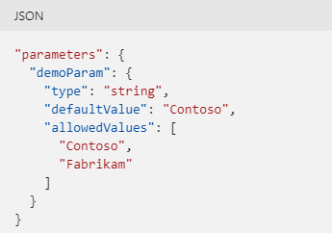
Default values
You can specify a default value for a parameter. The default value is used when a value isn't provided during deployment.

Slide 55
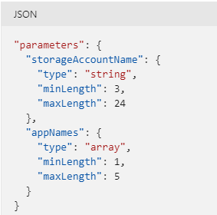
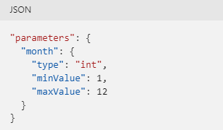
Parameter constraints
You can specify minimum and maximum lengths for string and array parameters. You can set one or both constraints. For strings, the length indicates the number of characters. For arrays, the length indicates the number of items in the array.
You can set minimum and maximum values for integer parameters. You can set one or both constraints.

Slide 56
Template variables
You use variables to simplify your template. Rather than repeating complicated expressions throughout your template, you define a variable that contains the complicated expression. Then, you use that variable as needed throughout your template.
Notes:
https://docs.microsoft.com/en-us/azure/azure-resource-manager/templates/variables

Slide 57
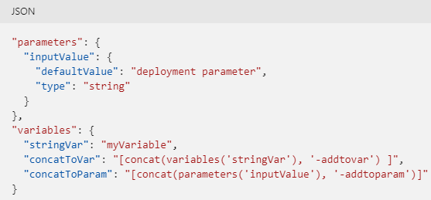
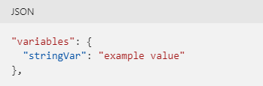
Define variable
When defining a variable, you don't specify a data type for the variable. Instead provide a value or template expression. The variable type is inferred from the resolved value. The following example sets a variable to a string.
To construct the variable, you can use the value from a parameter or another variable.

Slide 58
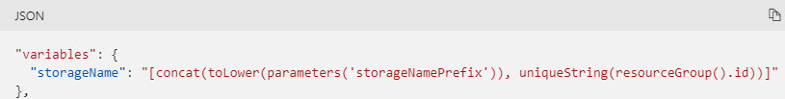
Template functions
You can use template functions to construct the variable value.
The following example creates a string value for a storage account name. It uses several template functions to get a parameter value, and concatenates it to a unique string.
Notes:
https://docs.microsoft.com/en-us/azure/azure-resource-manager/templates/template-functions

Slide 59
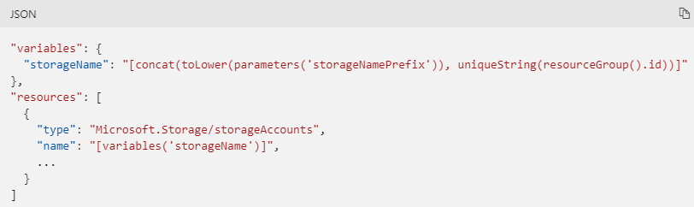
Use variable
To reference the value for the variable, use the variables function.

Slide 60
Template user-defined functions
Within your template, you can create your own functions. These functions are available for use in your template. User-defined functions are separate from the standard template functions that are automatically available within your template. Create your own functions when you have complicated expressions that are used repeatedly in your template.
Notes:
https://docs.microsoft.com/en-us/azure/azure-resource-manager/templates/user-defined-functions

Slide 61
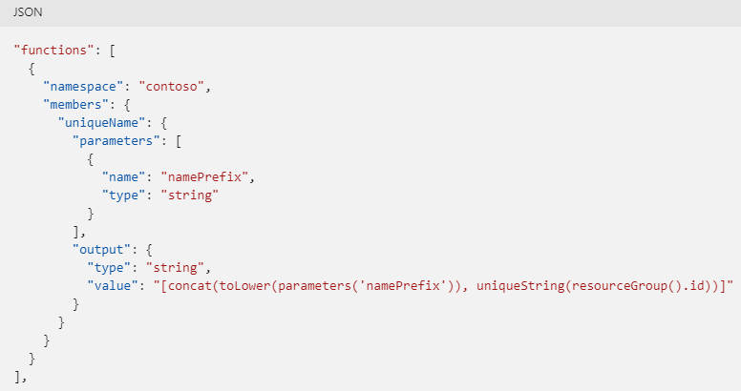
Define the function
Your functions require a namespace value to avoid naming conflicts with template functions. The following example shows a function that returns a unique name:

Slide 62
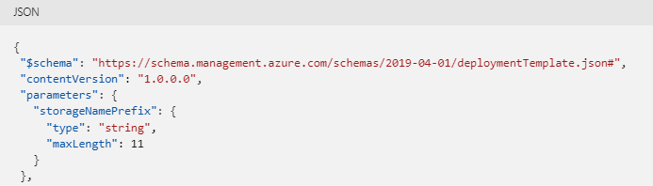
Use the function
The following example shows a template that includes a user-defined function to get a unique name for a storage account. The template has a parameter named storageNamePrefix that is passed as a parameter to the function.

Slide 63
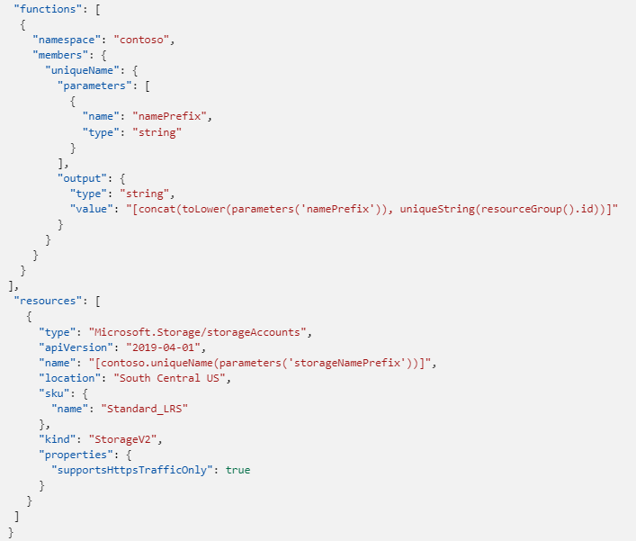

Slide 64
limitations
When defining a user function, there are some restrictions:
The function can't access variables.
The function can only use parameters that are defined in the function. When you use the parameters function within a user-defined function, you're restricted to the parameters for that function.
The function can't call other user-defined functions.
The function can't use the reference function or any of the list functions.
The function can't use the dateTimeAdd function.
Parameters for the function can't have default values.
Notes:
https://docs.microsoft.com/en-us/azure/azure-resource-manager/templates/template-functions-resource#reference
https://docs.microsoft.com/en-us/azure/azure-resource-manager/templates/template-functions-resource#list
https://docs.microsoft.com/en-us/azure/azure-resource-manager/templates/template-functions-date#datetimeadd

Slide 65
Template resources
To deploy a resource through an Azure Resource Manager template (ARM template), you add a resource declaration. Use the resources array in a JSON template.
Notes:
https://docs.microsoft.com/en-us/azure/azure-resource-manager/templates/resource-declaration

Slide 66
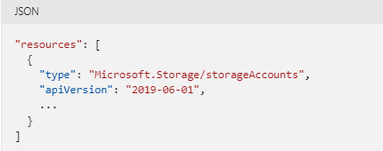
Set resource type and version
When adding a resource to your template, start by setting the resource type and API version. These values determine the other properties that are available for the resource.
The following example shows how to set the resource type and API version for a storage account. The example doesn't show the full resource declaration.

Slide 67
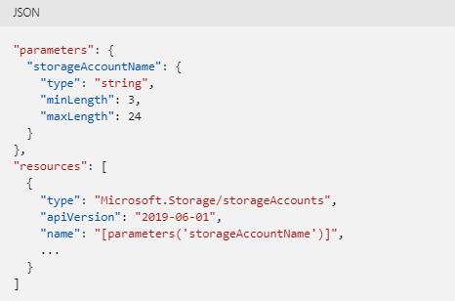
Set resource name
Each resource has a name. When setting the resource name, pay attention to the rules and restrictions for resource names.
Notes:
https://docs.microsoft.com/en-us/azure/azure-resource-manager/management/resource-name-rules

Slide 68
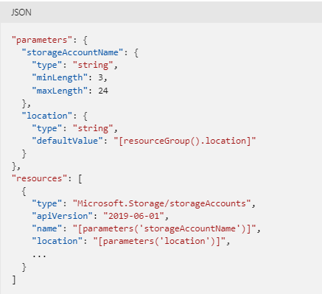
Set location
Many resources require a location. You can determine if the resource needs a location either through intellisense or template reference. The following example adds a location parameter that is used for the storage account.
Notes:
https://docs.microsoft.com/en-us/azure/templates/

Slide 69
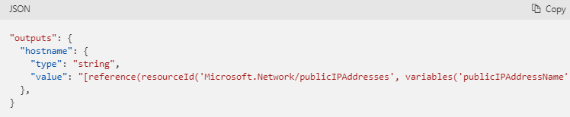
Template outputs
The following example shows how to return a property from a deployed resource.
Add the outputs section to the template. The output value gets the fully qualified domain name for a public IP address.
If you need to output a property that has a hyphen in the name, use brackets around the name instead of dot notation. For example, use ['property-name'] instead of .property-name.
"value": "[reference(resourceId('Microsoft.Network/publicIPAddresses', variables('publicIPAddressName'))).dnsSettings.fqdn]"
Notes:
https://docs.microsoft.com/en-us/azure/azure-resource-manager/templates/outputs

Slide 70
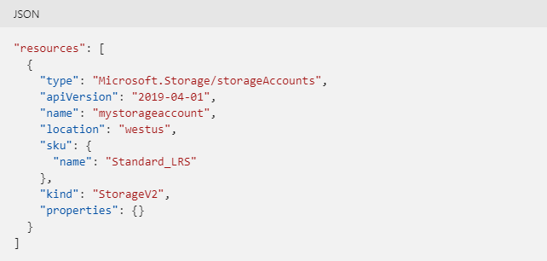
Template deployment process
When you deploy a template, Resource Manager converts the template into REST API operations. For example, when Resource Manager receives a template with the following resource definition:

Slide 71
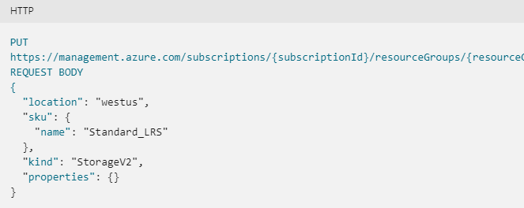
Template deployment process
It converts the definition to the following REST API operation, which is sent to the Microsoft.Storage resource provider:
https://management.azure.com/subscriptions/{subscriptionId}/resourceGroups/{resourceGroupName}/providers/Microsoft.Storage/storageAccounts/mystorageaccount?api-version=2019-04-01

Slide 72
Template deployment
To deploy a template, use any of the following options:
Azure portal
Azure CLI
PowerShell
REST API
Button in GitHub repository
Azure Cloud Shell
Notes:
https://docs.microsoft.com/en-us/azure/azure-resource-manager/templates/deploy-portal
https://docs.microsoft.com/en-us/azure/azure-resource-manager/templates/deploy-cli
https://docs.microsoft.com/en-us/azure/azure-resource-manager/templates/deploy-powershell
https://docs.microsoft.com/en-us/azure/azure-resource-manager/templates/deploy-rest
https://docs.microsoft.com/en-us/azure/azure-resource-manager/templates/deploy-to-azure-button
https://docs.microsoft.com/en-us/azure/azure-resource-manager/templates/deploy-cloud-shell

Slide 73
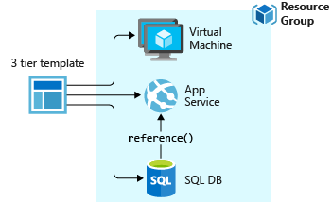
Template design
How you define templates and resource groups is entirely up to you and how you want to manage your solution. For example, you can deploy your three tier application through a single template to a single resource group.

Slide 74
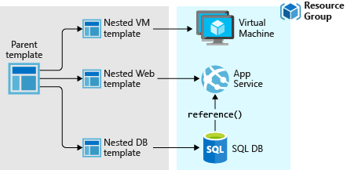
Template design
But, you don't have to define your entire infrastructure in a single template. Often, it makes sense to divide your deployment requirements into a set of targeted, purpose-specific templates. You can easily reuse these templates for different solutions. To deploy a particular solution, you create a main template that links all the required templates. The following image shows how to deploy a three tier solution through a parent template that includes three nested templates.

Slide 75
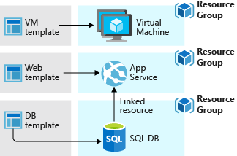
Template design
If you envision your tiers having separate lifecycles, you can deploy your three tiers to separate resource groups. Notice the resources can still be linked to resources in other resource groups.
Notes:
https://docs.microsoft.com/en-us/azure/azure-resource-manager/templates/linked-templates

Slide 76
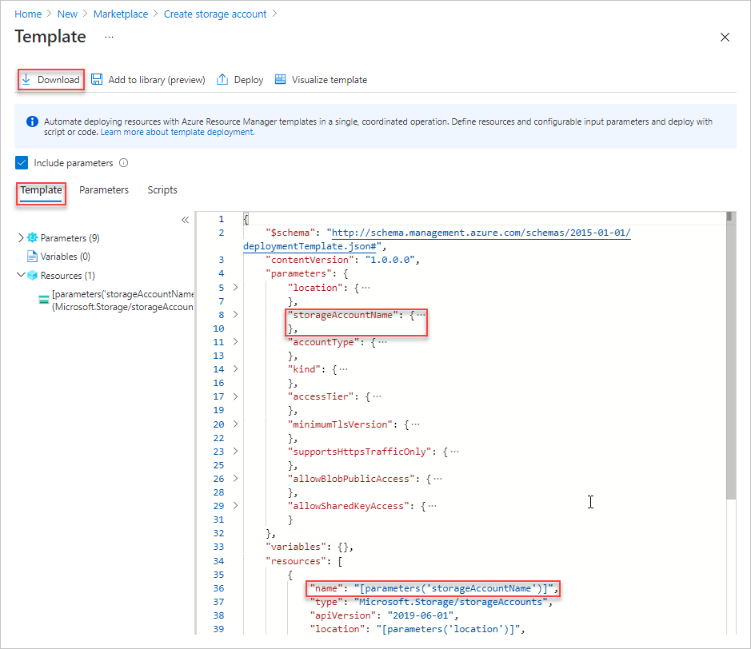
Arm and azure portal
Notes:
https://docs.microsoft.com/en-us/azure/azure-resource-manager/templates/quickstart-create-templates-use-the-portal

Slide 77
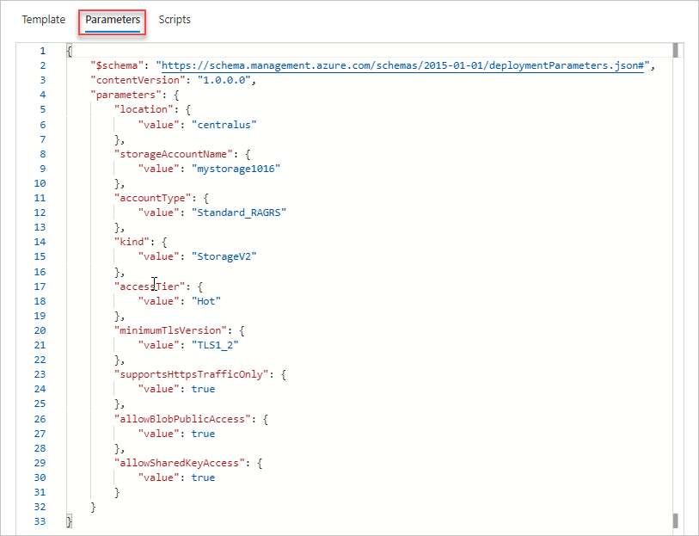

Slide 78
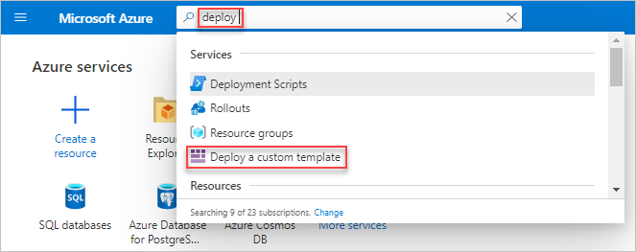
Azure portal deploy template

Slide 79
Arm and visual studio code
The Azure Resource Manager Tools for Visual Studio Code provide language support, resource snippets, and resource autocompletion. These tools help create and validate Azure Resource Manager templates (ARM templates). In this quickstart, you use the extension to create an ARM template from scratch. While doing so you experience the extensions capabilities such as ARM template snippets, validation, completions, and parameter file support.
Notes:
https://docs.microsoft.com/en-us/azure/azure-resource-manager/templates/quickstart-create-templates-use-visual-studio-code?tabs=CLI
https://marketplace.visualstudio.com/items?itemName=msazurermtools.azurerm-vscode-tools

Slide 80
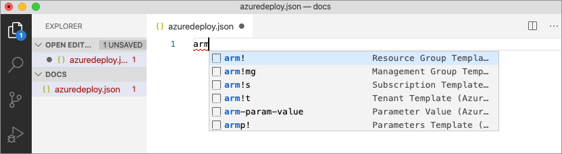
Arm and visual studio code
Create and open with Visual Studio Code a new file named azuredeploy.json. Enter arm into the code editor, which initiates Azure Resource Manager snippets for scaffolding out an ARM template.
Select arm! to create a template scoped for an Azure resource group deployment.

Slide 81
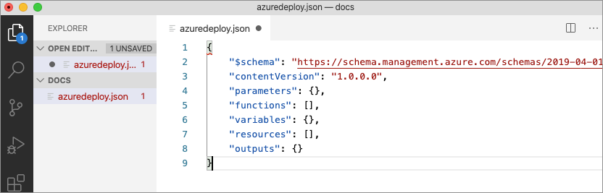
Arm and visual studio code
This snippet creates the basic building blocks for an ARM template.

Slide 82
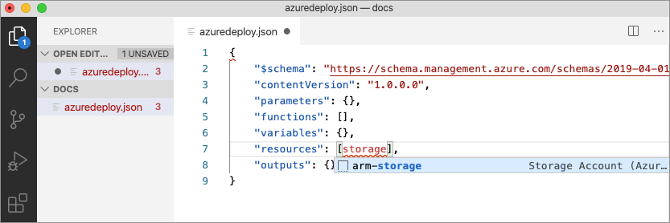
Arm and visual studio code
The extension includes snippets for many Azure resources. These snippets can be used to easily add resources to your template deployment.
Place the cursor in the template resources block, type in storage, and select the arm-storage snippet.

Slide 83
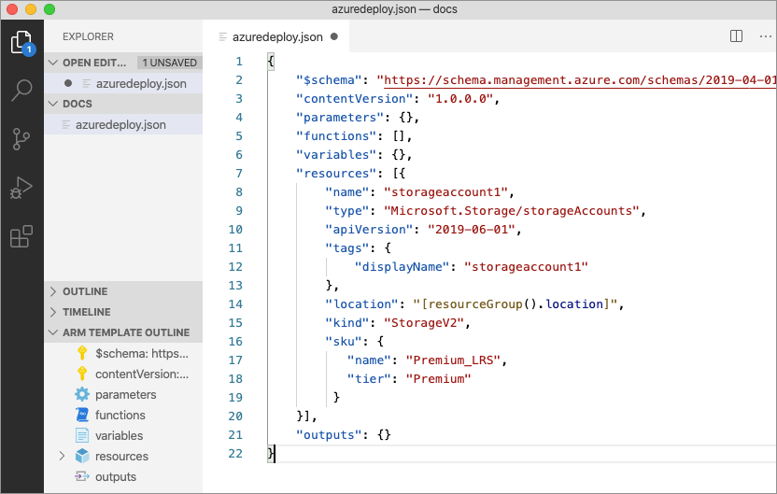
Arm and visual studio code
This action adds a storage resource to the template.

Slide 84
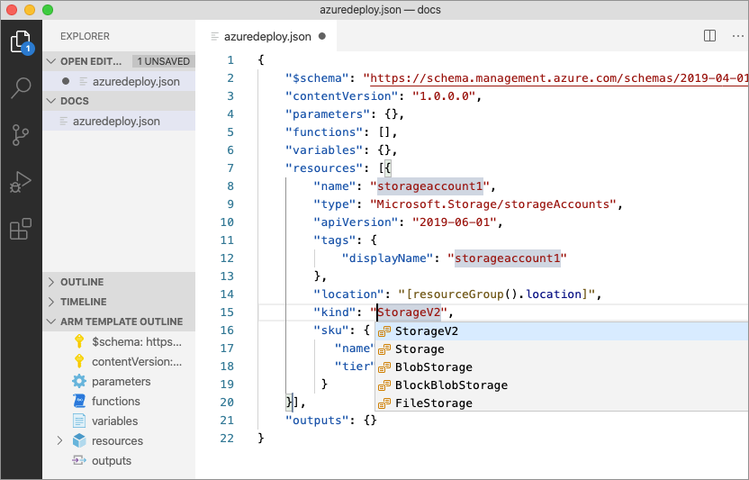
Arm and visual studio code
The tab key can be used to tab through configurable properties on the storage account.

Slide 85
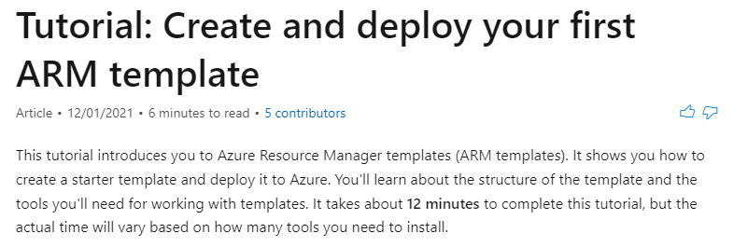
ARM templates exercise
https://docs.microsoft.com/en-us/azure/azure-resource-manager/templates/template-tutorial-create-first-template?tabs=azure-powershell

Slide 86
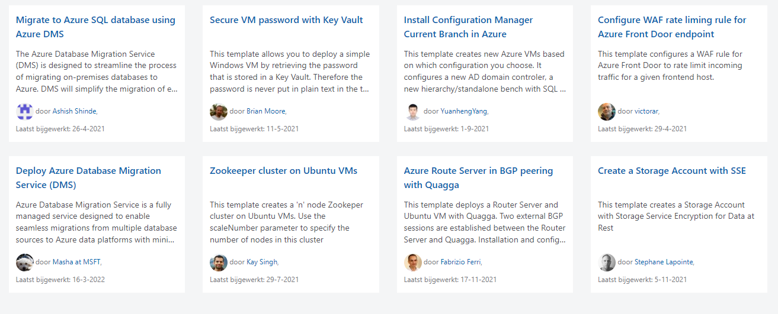
Azure quickstart
https://azure.microsoft.com/nl-nl/resources/templates/
Notes:
https://azure.microsoft.com/nl-nl/resources/templates/

Slide 87

Arm quickstart exercise
https://docs.microsoft.com/en-us/azure/azure-resource-manager/templates/template-tutorial-quickstart-template?tabs=azure-powershell

Slide 88

Azure architecture center
https://docs.microsoft.com/en-us/azure/architecture/
Notes:
https://docs.microsoft.com/en-us/azure/architecture/patterns/

Slide 89

Azure architecture center
https://docs.microsoft.com/en-us/azure/architecture/industries/manufacturing

Slide 90

Azure architecture center
https://docs.microsoft.com/en-us/azure/architecture/data-guide/databases-architecture-design

